Slide 1
Alojz Gomola
Rules of the Air within Reach Set SAA
4th April 2018
Progress report on framework development

Slide 2

Presentation Summary
Just read the Bold Text …
Rules of the Air Context
Framework Elements
UAS Traffic Management
Collision Case and Resolution
Rules of The Air
Rule Engine
Rule Engine Concept
Joint Point Definitions
Test Rule Configurations
Trajectory Disabling Rules
Before Avoidance Rule
After Avoidance Rule
Collision Case Resolution Rule
Maneuver Rules
ACAS-XU Reach Set Approximation
ACAS-XU in context SAA for UAS
DAA separations from ACAS-X
DAA separations
Emergency and Planned Avoidance
Concept of Emergency Avoidance
Concept of Planned Avoidance
Standard Scenarios simulations:
Converging Maneuver
Head On Approach
Multiple Collisions
Overtake at different speeds
Summary and Future Research

Slide 3

Rules of the Air Context Introduction

Slide 4
Framework
We have this architecture:
ADS-B
Obstacle Map
LiDAR
Rule Engine
Data fusion
Mission Plan
Avoidance grid
Let us focus on Rules
Vehicle control
Movement Automaton
Reach set estimation
Notes:
Rule engine then selects goal of avoidance and Next decision point (There is primitive hard-coded set of rules)
Avoidance grid have been fully implemented and tested for simple plane model in Matlab

Slide 5
Covered Functionality
Reach set based framework covering:
Path planning,
Evolving world,
Adversarial,
Data fusion,
Static restrictions,
Weather,
Rules
ADS-B
Obstacle Map
LiDAR
Rule Engine
Data fusion
Mission Plan
Avoidance grid
Vehicle control
Movement Automaton
Reach set estimation
Notes:
Rule engine then selects goal of avoidance and Next decision point (There is primitive hard-coded set of rules)
Avoidance grid have been fully implemented and tested for simple plane model in Matlab

Slide 6
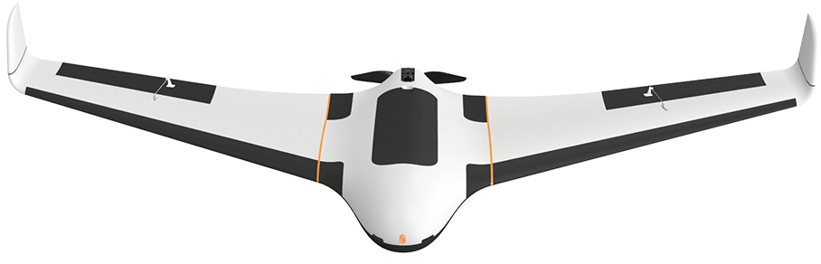
Current Architecture in Nutshell
We have standard noncooperative framework
based on Reach Sets
UAV 1 (S-Rotor)
Navigation Grid
Mission Control
Mission Control responsible for:
Waypoint management,
Priority checkup,
Vehicle safety.
Navigation Grid responsible for:
Navigation in open space.
Avoidance Grid responsible for:
Intruder avoidance
Obstacle avoidance
Avoidance Grid
UAV 2 (FACAS)
Navigation Grid
Mission Control
Avoidance Grid

Slide 7
Avoidance in the nutshell
What is a reason to have
two separate grids ?
UAV 1 (S-Rotor)
Navigation Grid
To separate:
Event based avoidance
When sky is clear we can consider to apply man made rules.
Situation based avoidance
When situation arises, we need to protect ourselves
Mission Control
Avoidance Grid
Preemptive based
Event based
Situation based
Well defined Waypoints
Free Space guarantee
Preflight preparation
Legal compliance
Targets of avoidance:
Cooperative intruders (Rules of the air)
Bad weather
Geofencing
Targets of avoidance:
Non-Cooperative intruders
Terrain
Other physical obstacles

Slide 8
UTM Module Introduction
We have standard noncooperative framework
based on Reach Sets
UAV 1 (S-Rotor)
Navigation Grid
Mission Control
There is need for
UASTrafficManagement (UTM)
provide C2 link and
cooperative functionality
Avoidance Grid
UAV 2 (FACAS)
UAS Traffic Management
Navigation Grid
Mission Control
One module to rule them all
(USpace EU, UTM US)
Avoidance Grid

Slide 9
Which Functionality is Provided by UTM
Traffic management responsibilities (selected):
Separation – keep all airspace users (manned/unmanned) Well Clear.
Collision prevention – prevent collision and enforce rule compliance.
Conflict resolution – the UTM decides request satisfaction based on rules.
Separation:
Controlled Airspace is segregated into Flight Levels by 1000 feet's of Barometric Altitude (ASL).
Each Flight Level is considered as separated space with planar routing.
UAS can induce climb/descent maneuvers in local level altitude 250-750 feet.
UAS must ask for a permission to change flight levels and reserve multiple levels during take of and landing.
UAS must stay “Well clear” from any other traffic considering protection tube with given own radius (intruder radius).
ACAS-XU defines such separations.

Slide 10
Collision Prevention
Collision prevention is based on aircraft mode:
Descending – aircraft is changing flight levels from higher to lower during landing maneuver or during required descent given by flight plan.
Climbing – aircraft is changing flight levels from lower to higher during take off maneuver or during required ascend given by geographical features.
Horizontal Flight – aircraft is moving in same flight level (We will focus on this part), aircraft is required to keep:
Horizontal separation – avoid protection range of other aircrafts on same level
Vertical separation – avoid entering to protected zones of flight level (0-250 feet, 750-1000 feet) of local altitude in flight level.
Note: EuroContol/EASA separates flight levels based on barometric pressure in controlled region, therefore aircraft needs to have barometric altitude measurement equipment to fly in Controlled Airspace.

Slide 11
Conflict resolution
Conflict resolution is Event-based depending on proclaimed aircraft position, heading and velocity, and classification.
Collision Case is created for two conflict participants (for both):
Position (Latitude, Longitude, Flight level).
Velocity (Vectorizer, Planar),
Vehicle Category (Size/Maneuverability)
Trajectory Prediction (Planned/Predicted)
Collision point (Based on possible trajectory intersection)
Angle of Approach (to adversarial vehicle)
Collision type (Based on Angle of approach)
Avoidance role (Based on previous data and decision algorithm)
Note: This work is focused on resolution of Loitering incidents in same flight level. The UTM have final decision on Collision case opening/closing.

Slide 12
How is Collision Case resolved by UTM
Each vehicle is calculating Collision Cases to nearby vehicles,
UTM is also calculating Collision Cases to nearby vehicles,
UTM issues Resolution advisories or separation rules to prevent collision
Resolution
UAV 1 (S-Rotor)
Mission Control
Navigation Grid
Collision Case
Position notification
UAS Traffic Management
UAV 2 (FACAS)
Position notification
Mission Control
Navigation Grid
Resolution

Slide 13
What is Considered in UTM Resolution
What is considered in UTM Resolution processing:
Vehicle category (higher category is always favored)
Vehicle maneuverability (higher maneuverability is forced to avoidance)
Collision Point surroundings (other collision points in proximity)
Other Collision Cases related to aircrafts in current collision case or collision point.
The expected behavior of UAV platform is given by following table:
Intruder | Our vehicle | Priority
Manned aircraft | Any UAV | Manned aircraft
VLOS piloted UAV | VLOS piloted UAV | Coordinated avoidance
VLOS piloted UAV | Autonomous UAV | Autonomous UAV
Autonomous UAV | Autonomous UAV | Coordinated avoidance

Slide 14
Vehicle Category/Maneuverability
From highest to lowest:
Manned aviation in distress,
Balloon (manned),
Glider (manned),
Aerial towing (manned)
Airship (manned)
Other manned aviation
UAS Autonomous
RPAS
Note: This categorization reflects only Pilot community statement, the general priority rule is broken, because maneuverability and vulnerability should be always considered as ked decision factor.
From highest to lowest:
Altitude control (Balloon, Hovering aircraft)
Full control – no propulsion (Gliders of any sort)
Full control – gliding (Any aircraft of plane type)
Full control – VTOL (Any aircraft with VTOL )
Note: This categorization with vehicle cruising/maximal velocity should be main decision matter.
Original categorization is based on maneuverability (extended not)

Slide 15
Right of the Way Rules
Right of the way rules aid pilots in avoiding each other visually
The rules are found:
Part 91 Federal Aviation Regulation (USA)
ICAO Annex 2 -> Chapter 3 - General Rules -> 3.2 Avoidance of collisions -> 3.2.2 Right of way (International)
When aircrafts are converging, the right of way is generally given to the least maneuverable aircraft (higher class).
The aircraft now having the right of the way is to pass well clear of the aircraft not having the right of the way.
Application for rules of the air in case of UAV seems to be reduced to immediate avoidance in case of manned aviation adversary
The avoidance rules can be applied between the same class of UAV.

Slide 16

Rule Engine

Slide 17
Rule Engine Introduction
Rule Engine – configurable engine weaved into UTM, Mission Control, Avoidance Grid, Reach Set classes to enrich existing functionality.
Joint Point – point in process where rule engine is invoked,
Context – context passed to rule body
Rule – small piece of functionality
Rule Engine
Decision point
Context
Rule

Slide 18
Rule Engine Architecture
Context
Gather
Context
Rule Engine
Invoke
Engine
Joint Point
Mission Control
Rule
Navigation Grid
My mission
Velocity Recalculation
Invoke Rule Instance
Parser
Check condition:
Intruder Velocity
Application
Parse context:
Intruder Position
Take action:
Slow down
Condition

Slide 19
Rule Engine in Nutshell
Benefits:
Modularity – keep rule specific code separated in one class with given condition and impact application, maintain separate functionality .
Scalability – use piece wise code in navigation/avoidance/control frameworks, activate/deactivate aspects and specific behaviors.
Rule chaining – rule can be invoked from Joint Point, or from other rule body, for example specific maneuver rule can be invoked from resolution rule, this becomes especially handy when aspects of logical programing are necessary.
Shortcomings:
Border Case Testing – needs to be implemented to verify rule functionality as intended, the test conditions are hard to assume.
Configurability Bias – is induced at change of configuration.

Slide 20
Rule Engine Setup
0..*
0..*
0..*
Context
Joint Point
Rule
Mission Control
Before Avoidance Run
Detect Collision Cases
After Avoidance Run
Close Collision Cases
Navigation Grid
Trajectory Restriction
Resolve Collision Cases
Invoke based on:
Avoidance role
Converging Maneuver
Overtake
Head On Approach
Right Plane Heading
Forced invoke:
Enforce Safety Margin

Slide 21
Rule: Right Plane Heading
Collision Zone: For given vehicle position and collision point there exist a space division by plane defined between points parallel with Z axis. The separation divides operation space into:
Collision zone – all points on left from vehicle viewpoint,
Free zone – all points on the right form vehicle viewpoint.
Objective: Disable trajectories which are:
Heading into Collision zone,
Leading into Collision zone.
[o] Collision Point [-] Enabled Trajectories [ ] Reachable cells
[-] Separation Line [-] Disabled trajectories [ ] Unreachable cells
Context | Condition | Application
UAS Navigation Grid Collision Point (LOC) | There are feasible trajectories | Disable trajectories of Navigation grid

Slide 22
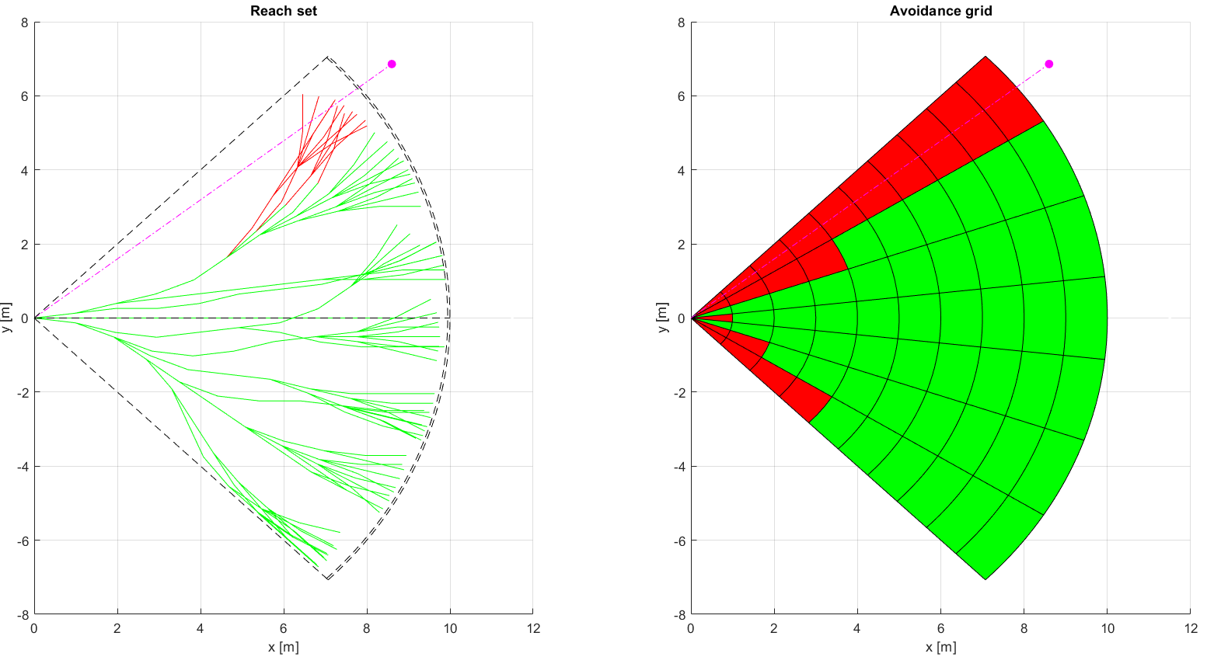
Right Plane Heading (1)

Slide 23
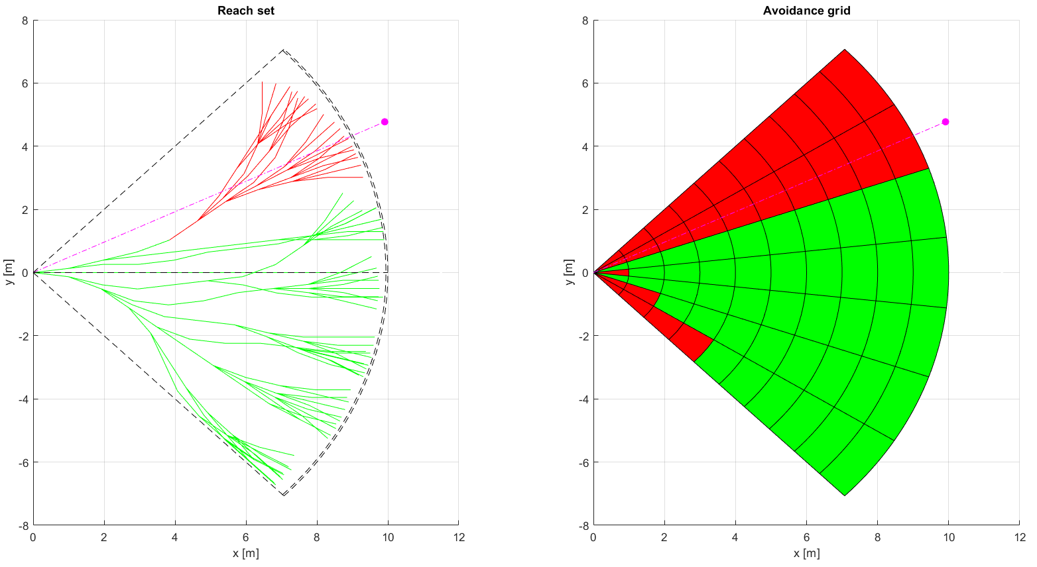
Right Plane Heading (2)

Slide 24
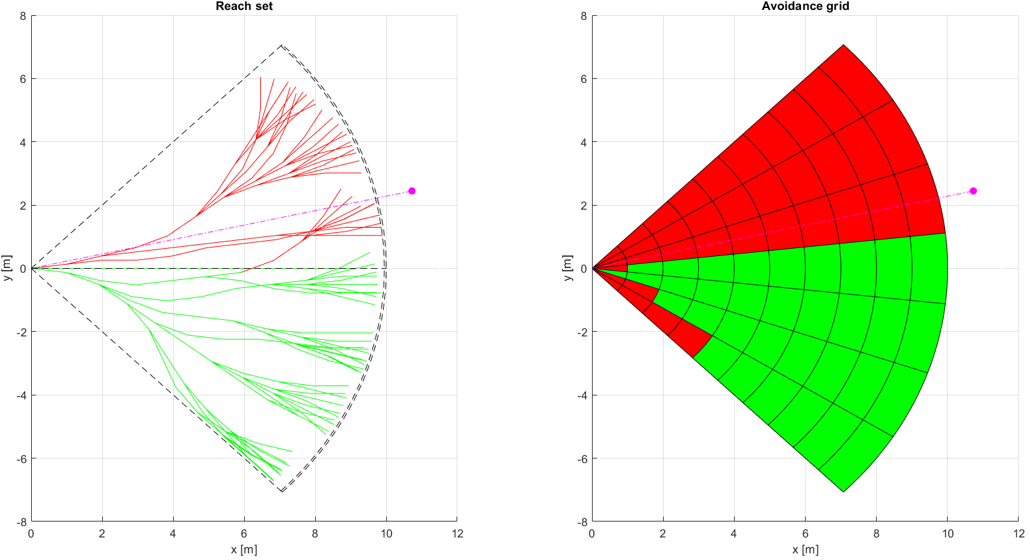
Right Plane Heading (3)

Slide 25
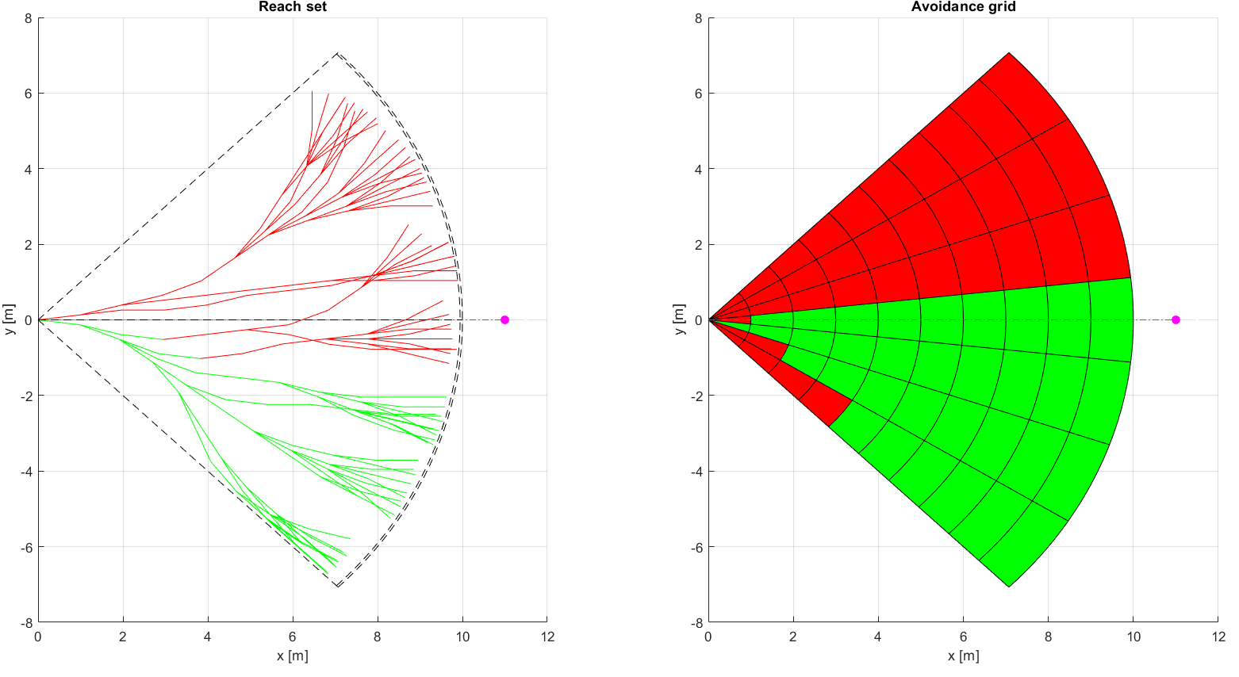
Right Plane Heading (4)

Slide 26
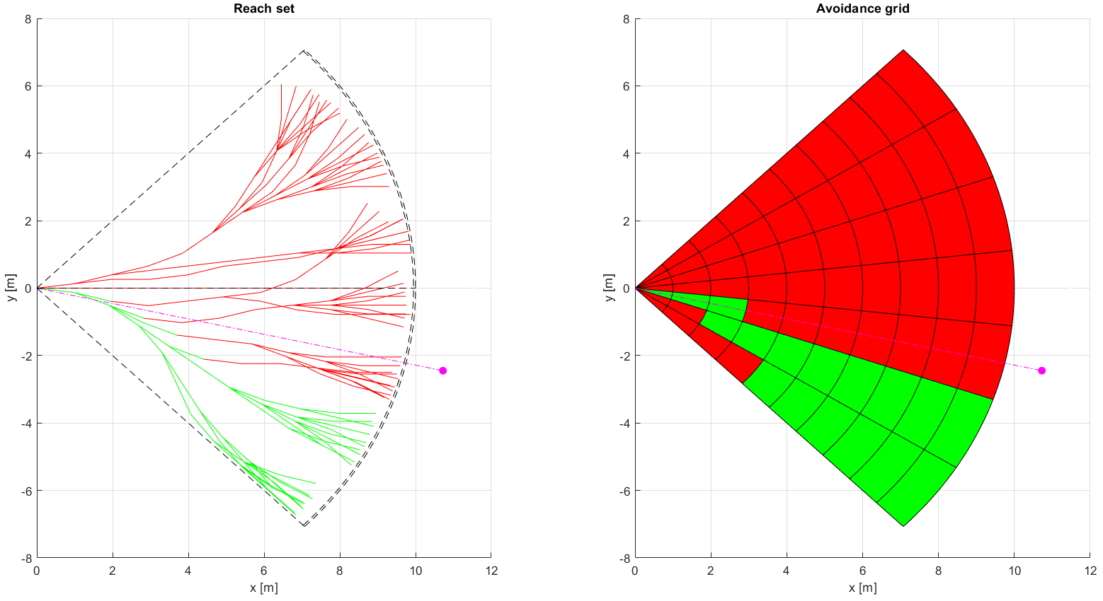
Right Plane Heading (5)

Slide 27
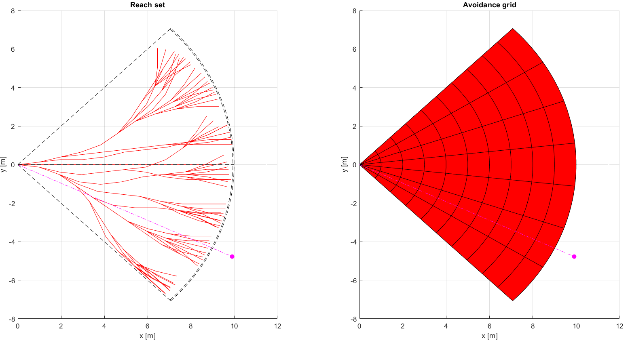
Right Plane Heading (6)

Slide 28

Disable Left Plane Heading (7)

Slide 29
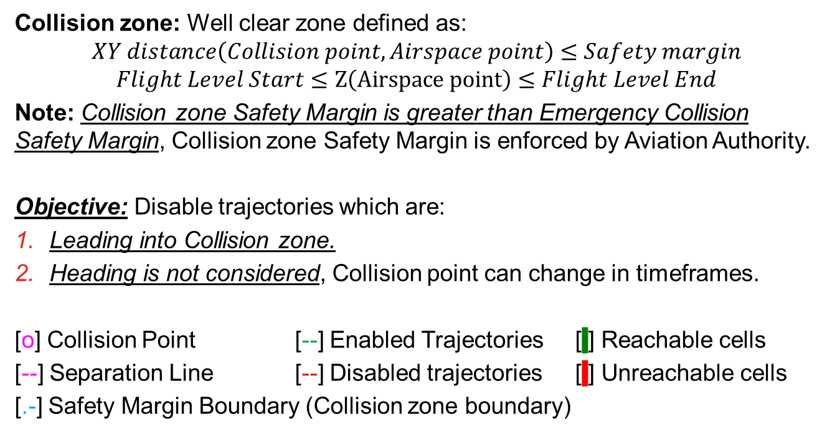
Rule: Enforce Safety Margin
Collision zone: Well clear zone defined as:
$$XY distance\left(Collision point, Airspace point\right)≤Safety margin$$
$$Flight Level Start≤Z\left(Airspace point\right)≤Flight Level End$$
Note: Collision zone Safety Margin is greater than Emergency Collision Safety Margin, Collision zone Safety Margin is enforced by Aviation Authority.
Objective: Disable trajectories which are:
Leading into Collision zone.
Heading is not considered, Collision point can change in timeframes.
[o] Collision Point [--] Enabled Trajectories [ ] Reachable cells
[--] Separation Line [--] Disabled trajectories [ ] Unreachable cells
[.-] Safety Margin Boundary (Collision zone boundary)
Context | Condition | Application
UAS Navigation Grid Collision Point (LOC) | There are feasible trajectories | Disable trajectories of Navigation grid

Slide 30
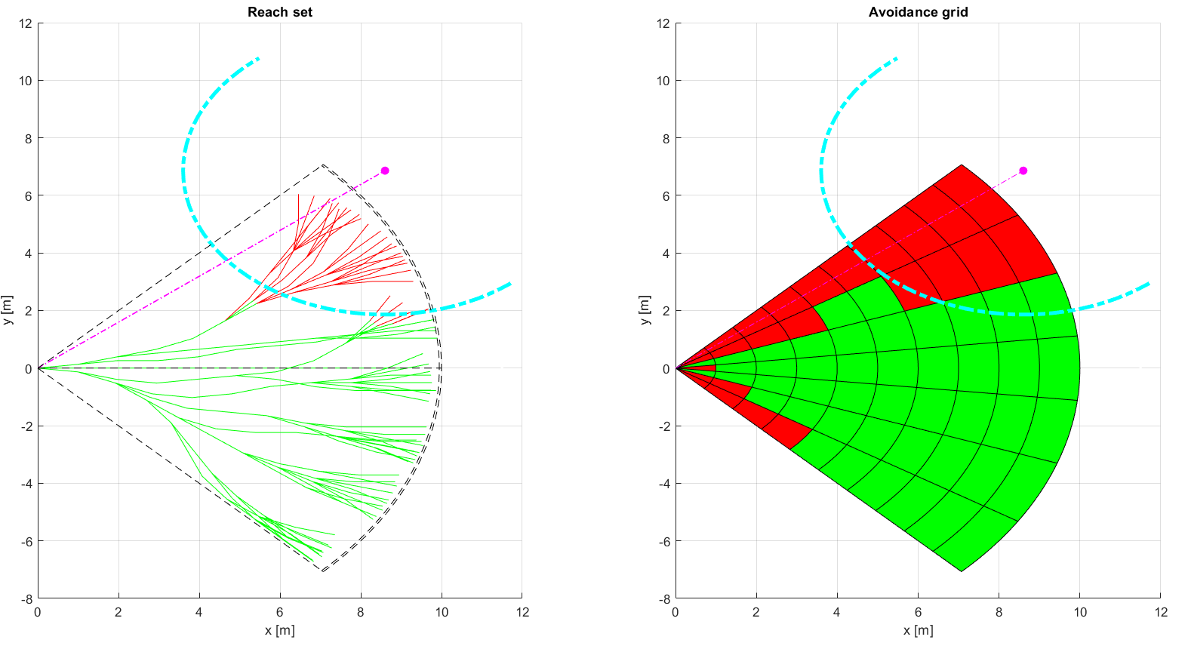
Enforce Safety Margin (1)

Slide 31
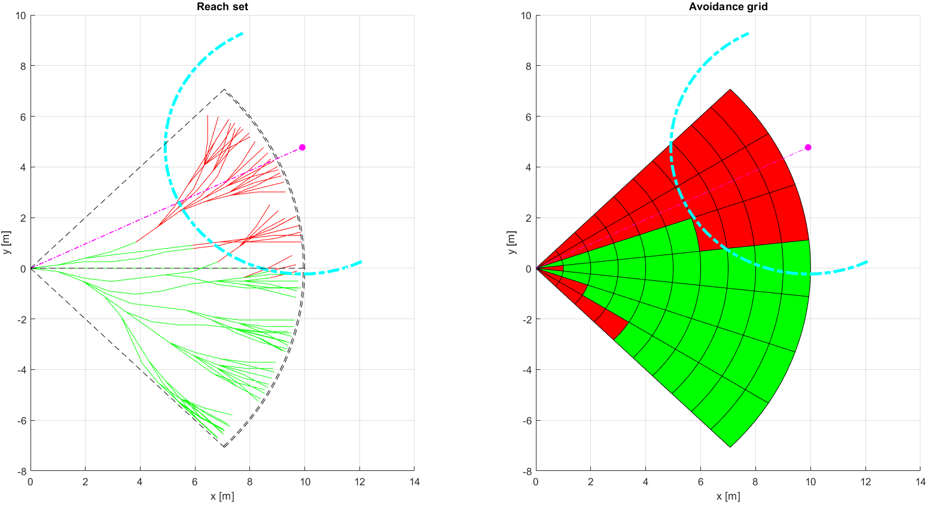
Enforce Safety Margin (2)

Slide 32
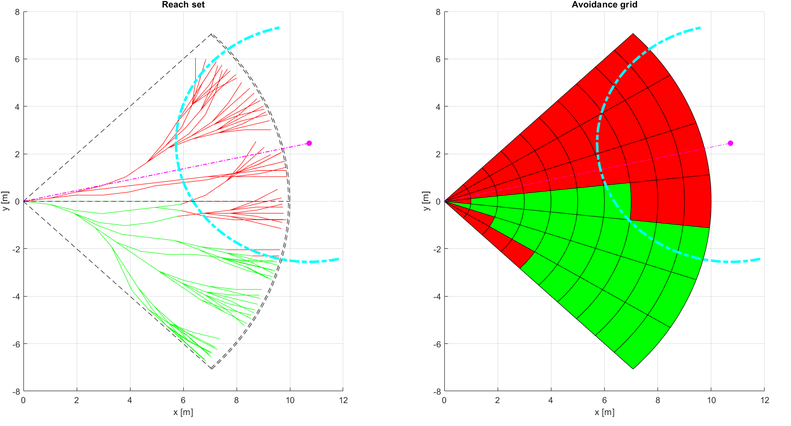
Enforce Safety Margin (3)

Slide 33
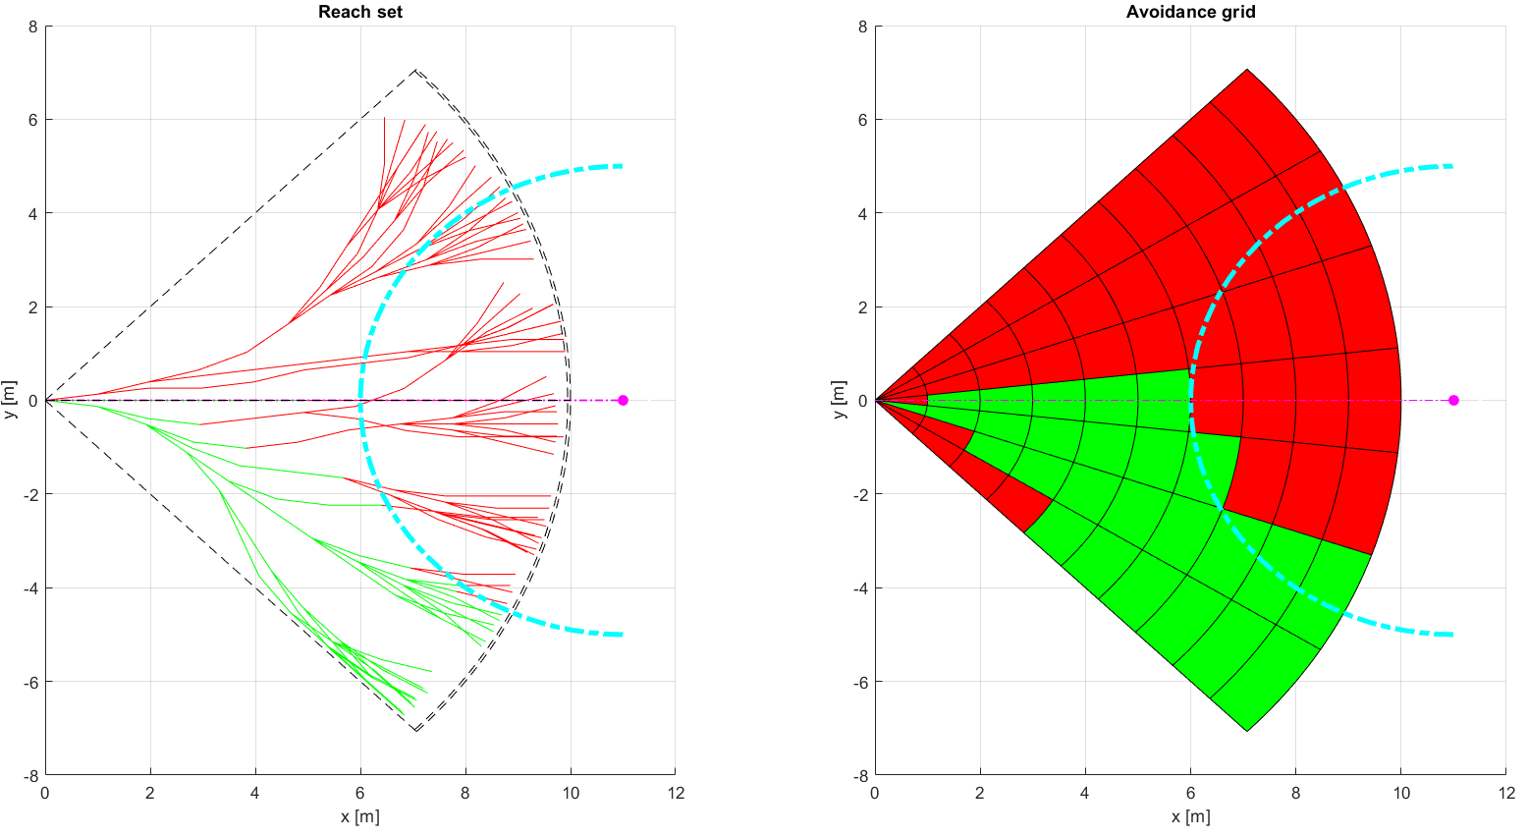
Enforce Safety Margin (4)

Slide 34
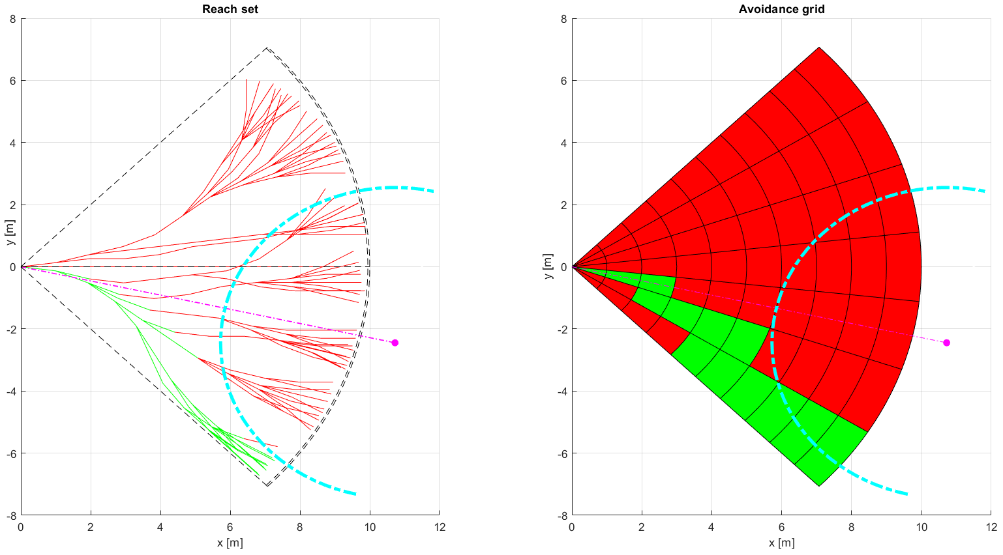
Enforce Safety Margin (5)

Slide 35
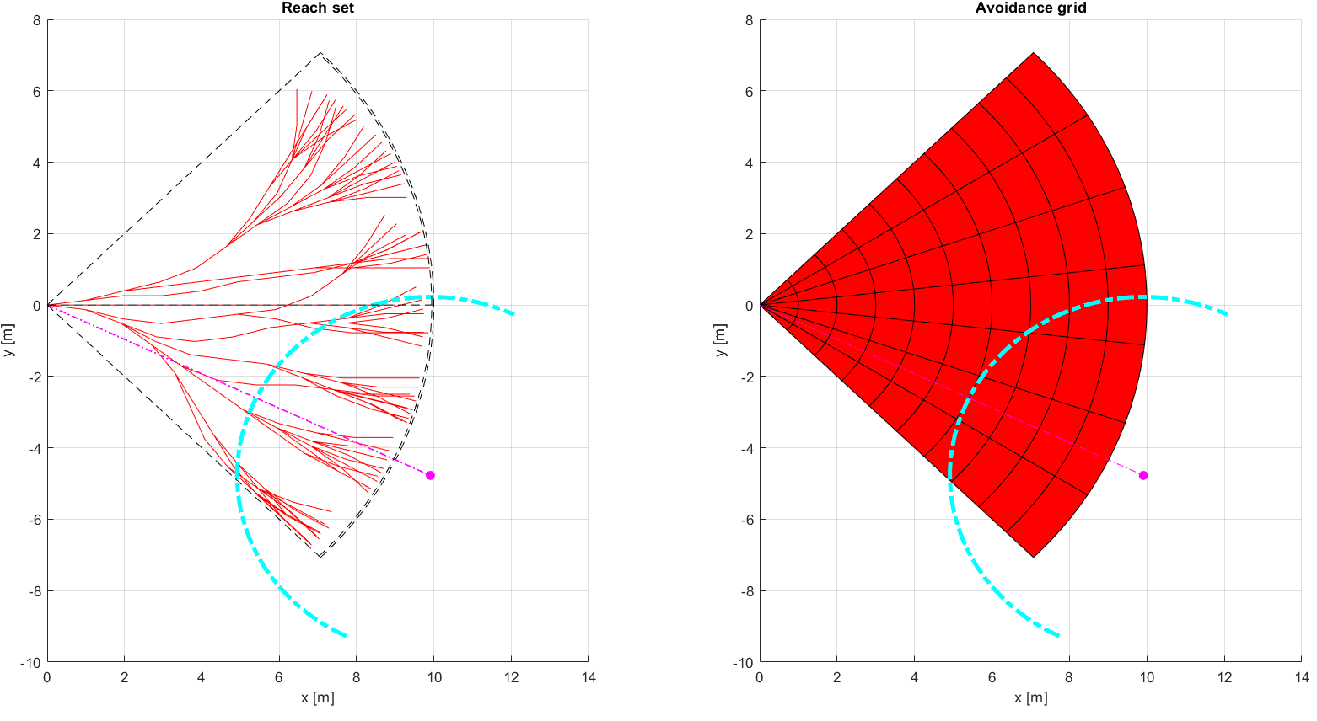
Enforce Safety Margin (6)

Slide 36
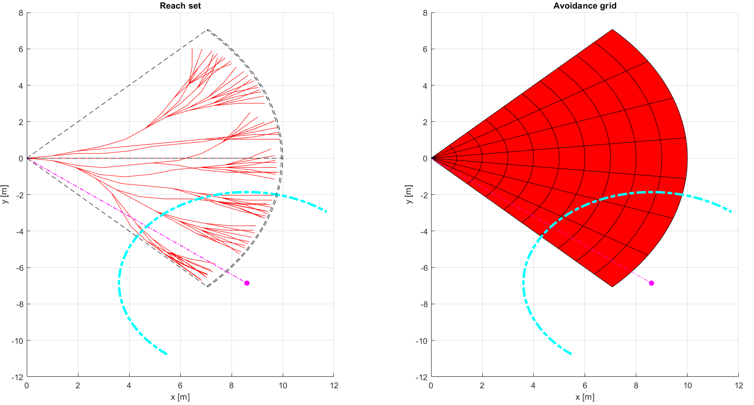
Enforce Safety Margin (7)

Slide 37
Rule: Detect Collision Cases
Invocation: Every Decision Point in UAS main navigation loop.
Objective: Prepare Collision Cases for evasive maneuvers application
Fetch UTM Collision Cases for given timeframe,
Create/Update own Collision Cases for given timeframe,
Merge Collision cases based on source priority order,
Select Active Collision Cases based on following conditions:
Active participation in collision case => avoidanceRole ~= Right of the Way,
Collision Point is in front of vehicle,
Emergency mode of all Collision Case participants is INACTIVE.
Order Collision Cases based on SEVERENITY (descending),
If there is at least one active collision case enforce inner Avoidance Run.
Context | Condition | Application
UAS Mission Control Before Avoidance Run, UTM/UAS Col. Cases | Clean Avoidance Grid, No higher Avoidance priority, | Active Collision Cases selection, Prioritization

Slide 38
Rule: Resolve Collision Case
Invocation: This rule is invoked only if there is any active Collision Case in given Navigation Grid timeframe, moreover Avoidance Grid should be empty.
Objective: Based on own calculated collision cases and UTM directives (has higher priority):
Fetch Active Collision Cases(Avoidance Role, Collision Point)
Enforce Rules based on Avoidance Role and Collision Point as:
Converging Maneuver – invoke Rule: Converging Maneuver
Head On approach – invoke Rule: Head On Approach
Overtake – invoke Rule: Overtake
Emergency Maneuver – register intruder object into UAS Mission Control
Context | Condition | Application
UAS Mission Control, Trajectory restriction, Collision Cases | Active UTM collision Case, Resolution mandate for UAV | Enforce Rules of Air OR Enforce Emergency

Slide 39
Rule: Close Collision Case
Invocation: There exists at least one Active Collision Case.
Objective: Ensure that multiple Avoidance Rules application gives feasible Avoidance Strategy, otherwise enter EMERGENCY MODE,
Collect rules applied on Navigation Grid from Active Collision Cases,
Calculate possible routes for Avoidance (there may be none),
If there is no Active Route: For each Intruder:
Issue warning message to containing expected Collision Point, and, Preferred Separation Type,
Create Intruder objects for Avoidance Grid
Calculate Evasive Maneuver based on Expected Separation.
Notify UTM about Collision Case Resolutions.
Notify UTM with Planned Trajectory and Avoidance Mode
Context | Condition | Application
UAS Mission Control, After Avoidance Run, Collision Resolutions | At least one route in Navigation Grid, Emergency check | Force Emergency Mode OR Close Collision Cases

Slide 40
Rule: Converging Maneuver
Invocation: When role of UAS is Converging and Avoidance Grid is Empty
Objective: Ensure that UAS will not enter into Intruder “Well clear” barell.
Prevent Left-Side Maneuvers
Prevent Converging Safety Margin Breach
Return to original Path
Prevent Wake turbulence.
Context | Condition | Application
UAS Navigation Grid Collision Point, Avoidance Role | None | RunRules: Right Plane Heading Enforce S. Margin

Slide 41
Rule: Head On Approach
Invocation: When role of UAS is Converging and Avoidance Grid is Empty
Objective: Ensure that UAS will not enter into Intruder “Well clear” barbell.
Prevent Left-Side Maneuvers,
Prevent Converging Safety Margin Breach,
Return to original Path,
Prevent Wake turbulence,
Enforce Round-about behavior,
Context | Condition | Application
UAS Navigation Grid Collision Point, Avoidance Role | None | Run rules: Right Plane Heading Enforce S. Margin

Slide 42
Rule: Overtake
Invocation: Invoked by rule Collision Case Resolution.
Divergence Waypoint: waypoint to diverge from original UAS path to ensure Intruder safety, within unchanged intruder velocity and heading.
Convergence Waypoint: waypoint when convergence to original UAS path is enabled, within unchanged intruder velocity and heading.
Objective:
Calculate Divergence Waypoint
Calculate Convergence Waypoint
Enforce Divergence/Convergence waypoint
Context | Condition | Application
UAS Navigation Grid Collision Point, Avoidance Role, | UAS Velocity >>>> Intruder Velocity | Calculate: Divergence WP Convergence WP

Slide 43
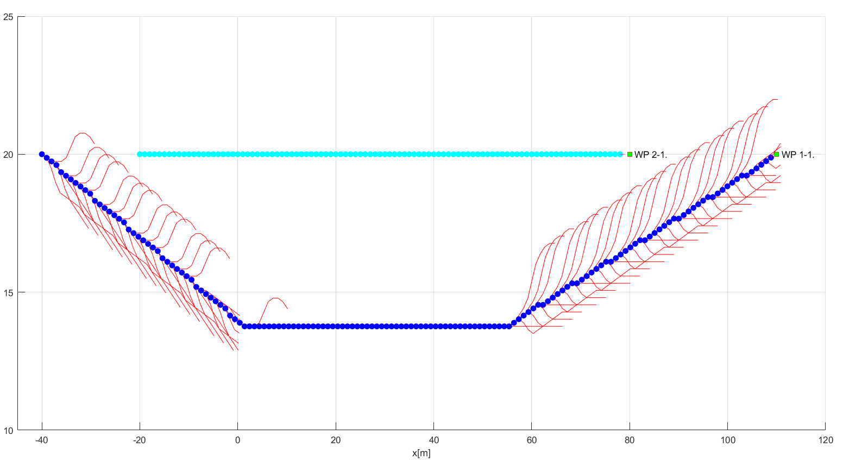
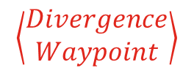
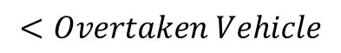
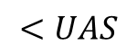
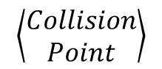
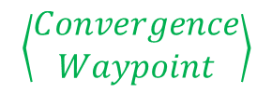
Divergence/Convergence Waypoint Example
$$\left\langle \begin{aligned}Collision \\ Point\end{aligned}\right\rangle$$
$$<UAS$$
$$<Overtaken Vehicle$$
$$\left\langle \begin{aligned}Divergence \\ Waypoint\end{aligned}\right\rangle$$
$$\left\langle \begin{aligned}Convergence \\ Waypoint\end{aligned}\right\rangle$$

Slide 44
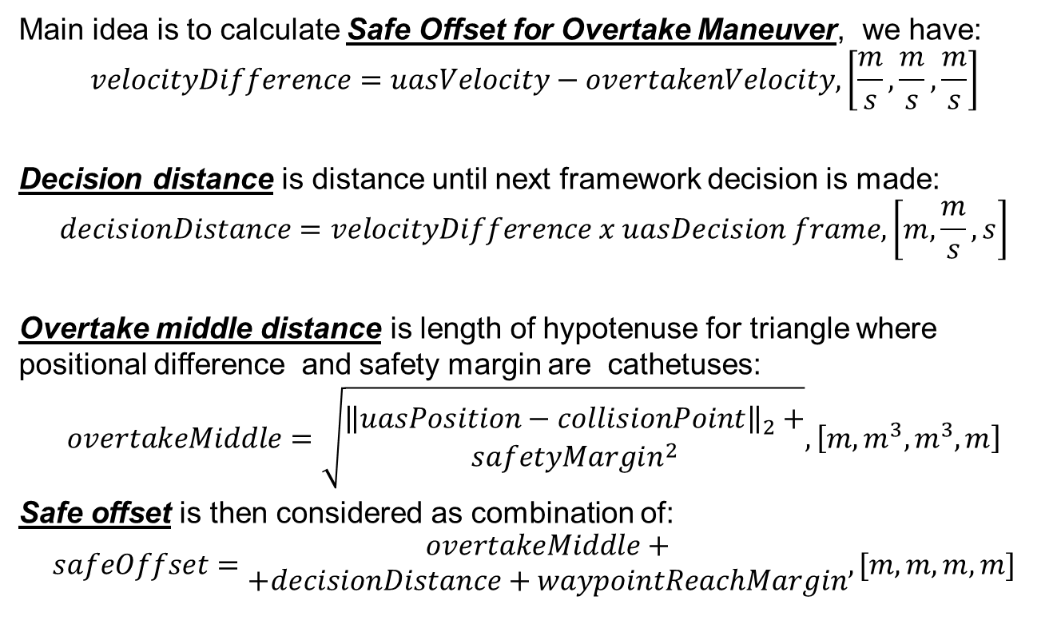
Divergence/Convergence Waypoint Calculation
Main idea is to calculate Safe Offset for Overtake Maneuver, we have:
$$velocityDifference=uasVelocity−overtakenVelocity, \left[\frac{m}{s},\frac{m}{s},\frac{m}{s}\right]$$
Decision distance is distance until next framework decision is made:
$$decisionDistance=velocityDifference x uasDecision frame, \left[m,\frac{m}{s},s\right]$$
Overtake middle distance is length of hypotenuse for triangle where positional difference and safety margin are cathetuses:
$$overtakeMiddle=\sqrt{\begin{matrix}{\left\|uasPosition−collisionPoint\right\|}_{2}+ \\ safetyMargin^{2}\end{matrix}}, \left[m,m^{3},m^{3},m\right]$$
Safe offset is then considered as combination of:
$$safeOffset=\begin{matrix}overtakeMiddle+ \\ +decisionDistance+waypointReachMargin\end{matrix}, [m,m,m,m]$$

Slide 45
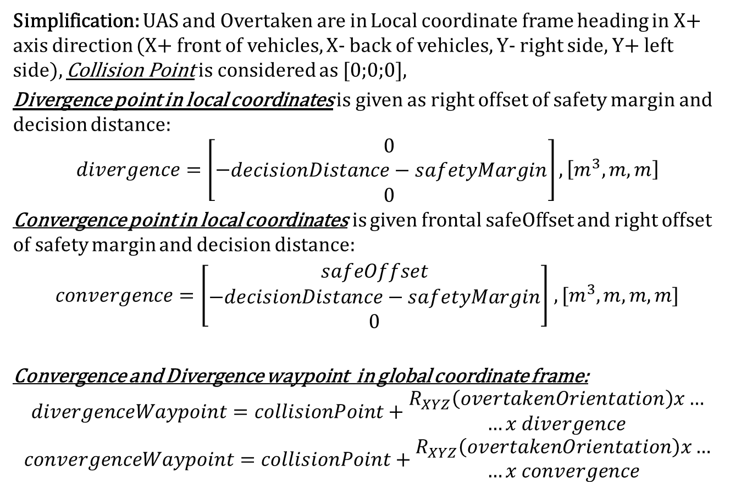
Divergence/Convergence Waypoint Calculation
Simplification: UAS and Overtaken are in Local coordinate frame heading in X+ axis direction (X+ front of vehicles, X- back of vehicles, Y- right side, Y+ left side), Collision Point is considered as [0;0;0],
Divergence point in local coordinates is given as right offset of safety margin and decision distance:
$$divergence=\left[−\begin{matrix}0 \\ decisionDistance−safetyMargin \\ 0\end{matrix}\right],\left[m^{3},m,m\right]$$
Convergence point in local coordinates is given frontal safeOffset and right offset of safety margin and decision distance:
$convergence=\left[\begin{matrix}safeOffset \\ −decisionDistance−safetyMargin \\ 0\end{matrix}\right]$ $,[m^{3},m,m,m]$
Convergence and Divergence waypoint in global coordinate frame:
$$divergenceWaypoint=collisionPoint+\begin{matrix}R_{XYZ}\left(overtakenOrientation\right)x… \\ …x divergence\end{matrix}$$
$$convergenceWaypoint=collisionPoint+\begin{matrix}R_{XYZ}\left(overtakenOrientation\right)x… \\ …x convergence\end{matrix}$$

Slide 46
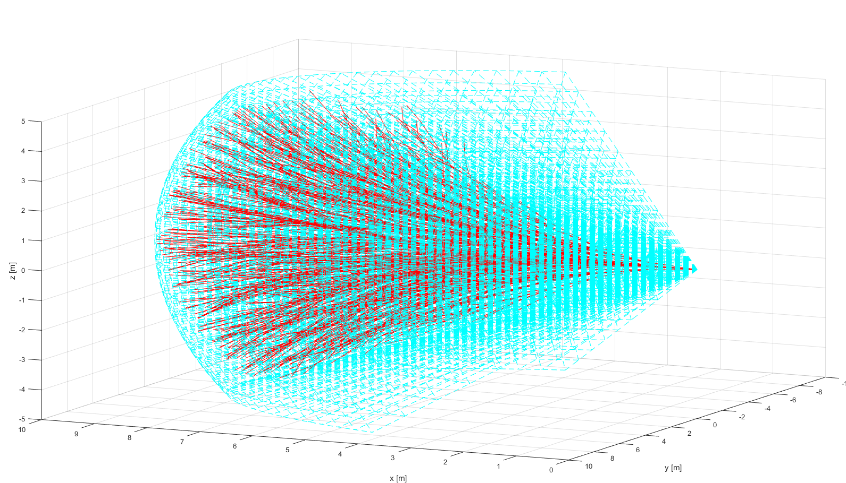
ACAS-XU Reach Set

Slide 47
ACAS-XU functionality as Reach Set
The Standard Controlled Airspace provides horizontal and vertical separation functionality, the separation in manned aviation is secured by TCAS I/II systems which issues Traffic Alerts and recommends Directional Changes Advices.
Next generation separation system family ACAS-X (in development) can issue Traffic Commands, taking Unmanned Aviation into account, the special framework ACAS-XU is dedicated for UAS systems (autonomous drones).
The ACAS-XU provides following separations:
Standard Separations – inherited from TCAS II and Other ACAS-X systems.
Combined Separations – native for ACAS-XU systems.
Restricted Reach Set estimation method is presented for following reasons:
Increase Framework variability and provide functionality for ACAS-XU
Prove that framework is independent of the used Reach Set Estimation method

Slide 48
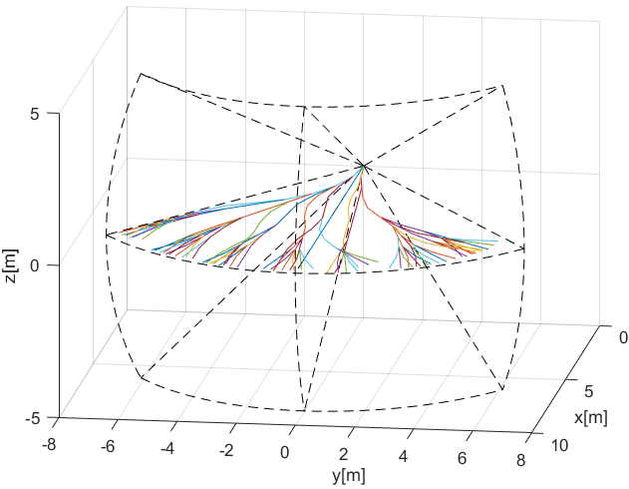
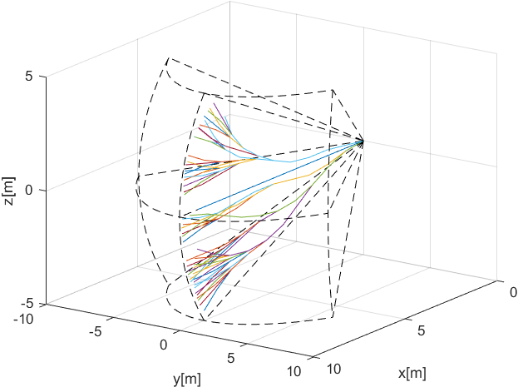
Standard Separations
Standard Separations are supported in other ACAS-X implementations as maneuver look-up tables, the trajectories are slightly diverged right (horizontal) and down (vertical) for support of standard TCAS II behavior and Rules of the Air implementation.
Horizontal Separation – standard separation in Flight Level area regardless of the altitude, horizontal separation would not break flight level therefore is preferred for conflict resolution.
Vertical separation – separation for aircrafts with better horizontal maneuverability.

Slide 49
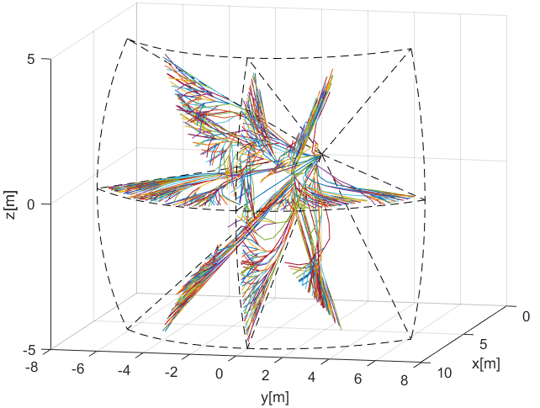
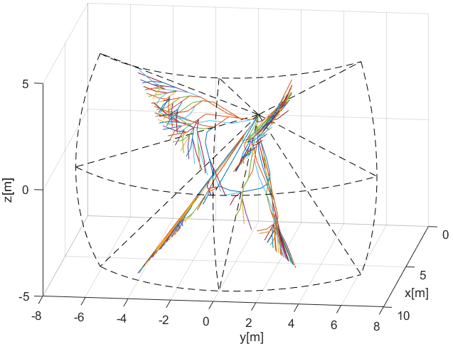
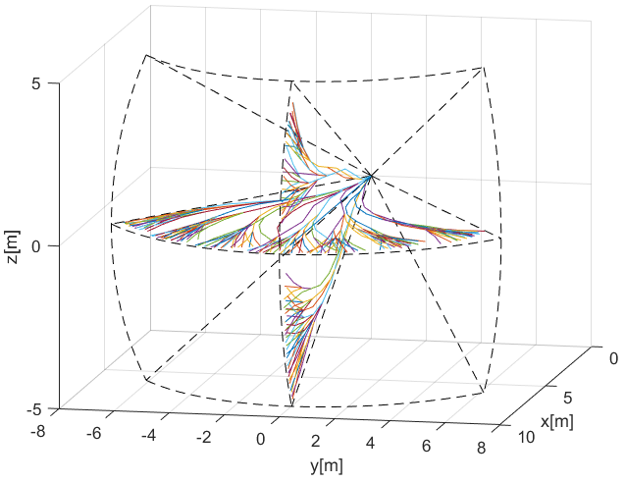
Combined Separations
Complete separations – containing horizontal vertical and tilted separations, closest to original Harmonic Reach set.
Horizontal/Vertical – containing horizontal and vertical separations, close to original TCAS II.
Tilted Left/Tilted Right – ACAS-XU

Slide 50
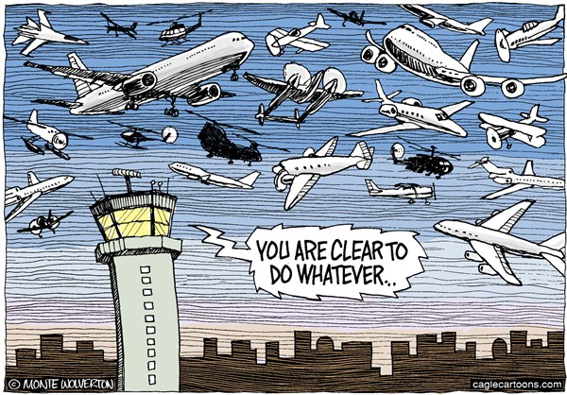

Emergency and Planned Avoidance

Slide 51
What is Going to be Tested
Time to do some testing
We are going to test:
Event Based Avoidance
Situation Based Avoidance
On standard ACAS/ICAO scenarios:
Converging Maneuver
Head On Approach
Multiple Collision Cases
Overtake (Multiple speeds)
Innocent UAS systems
Yay!
Reminder on Collision Avoidance Types
Preemptive based
Event based
Situation based
Well defined Waypoints
Free Space guarantee
Preflight preparation
Legal compliance
Targets of avoidance:
Cooperative intruders (Rules of the air)
Bad weather
Geofencing
Targets of avoidance:
Non-Cooperative intruders
Terrain
Other physical obstacles

Slide 52
Standard Scenarios
Converging Maneuver
Event Based:
2x UAS system
ADS-B I/O
Situation Based:
2x UAS system
ADS-B I/O
UTM Advisory
Head-On Approach
Event Based:
2x UAS system
ADS-B I/O
Situation Based:
2x UAS system
ADS-B I/O
UTM Advisory
Multiple Collision Cases
Event Based:
4x UAS system
ADS-B I/O
Situation Based:
4x UAS system
ADS-B I/O
UTM Advisory
Overtake
Situation Based
2x UAS system
ADS-B I/O
UTM Advisory
2x Overtaking/Overtaken velocity
3x Overtaking/Overtaken velocity
4x Overtaking/Overtaken velocity

Slide 53
Converging Maneuver
Situation:
Two UAS systems equipped with ADS-B are approaching Collision Point
Both systems are using ACAS-XU Horizontal Separation
Angle of Approach is equal to 90 degrees
Resolution (Emergency)
Both UAS receive ADS-B message with intruder heading and position
Safety margin: 1.2 m (30 cm body radius, 30 cm protection margin)
Intruder model: Time-Based, Body mass intersection (r=60 cm)
Resolution (Rule Based)
Both UAS broadcasts ADS-B message to UTM system
UTM creates Collision Case and Mandates UAS with Avoidance Roles
Safety margin: 8 m (Enforced in Navigation Grid)

Slide 54

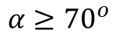
Converging Maneuver - Trigger
$$α≥{70}^{o}$$
Quick Recapitulation Time!
The aircraft on other right, has the right of the way

Slide 55
Converging Maneuver - Resolution
Turn right and stay away from approaching aircraft

Slide 56
Converging Maneuver – Leave condition
Return to original path behind other aircraft

Slide 57
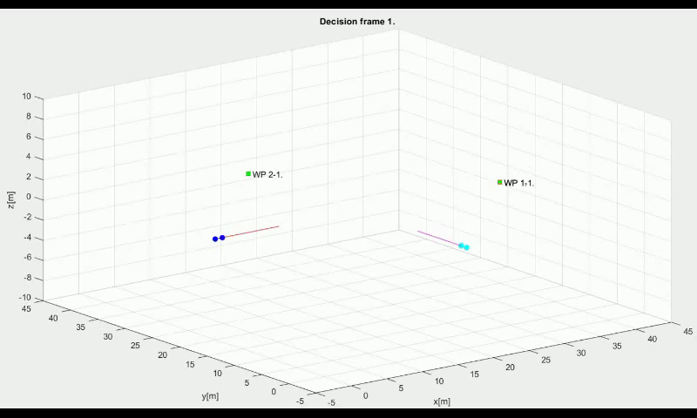
Emergency: Converging Maneuver

Slide 58
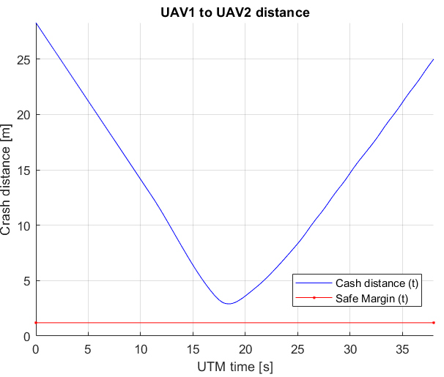
Emergency: Converging Maneuver
No Collision!

Slide 59
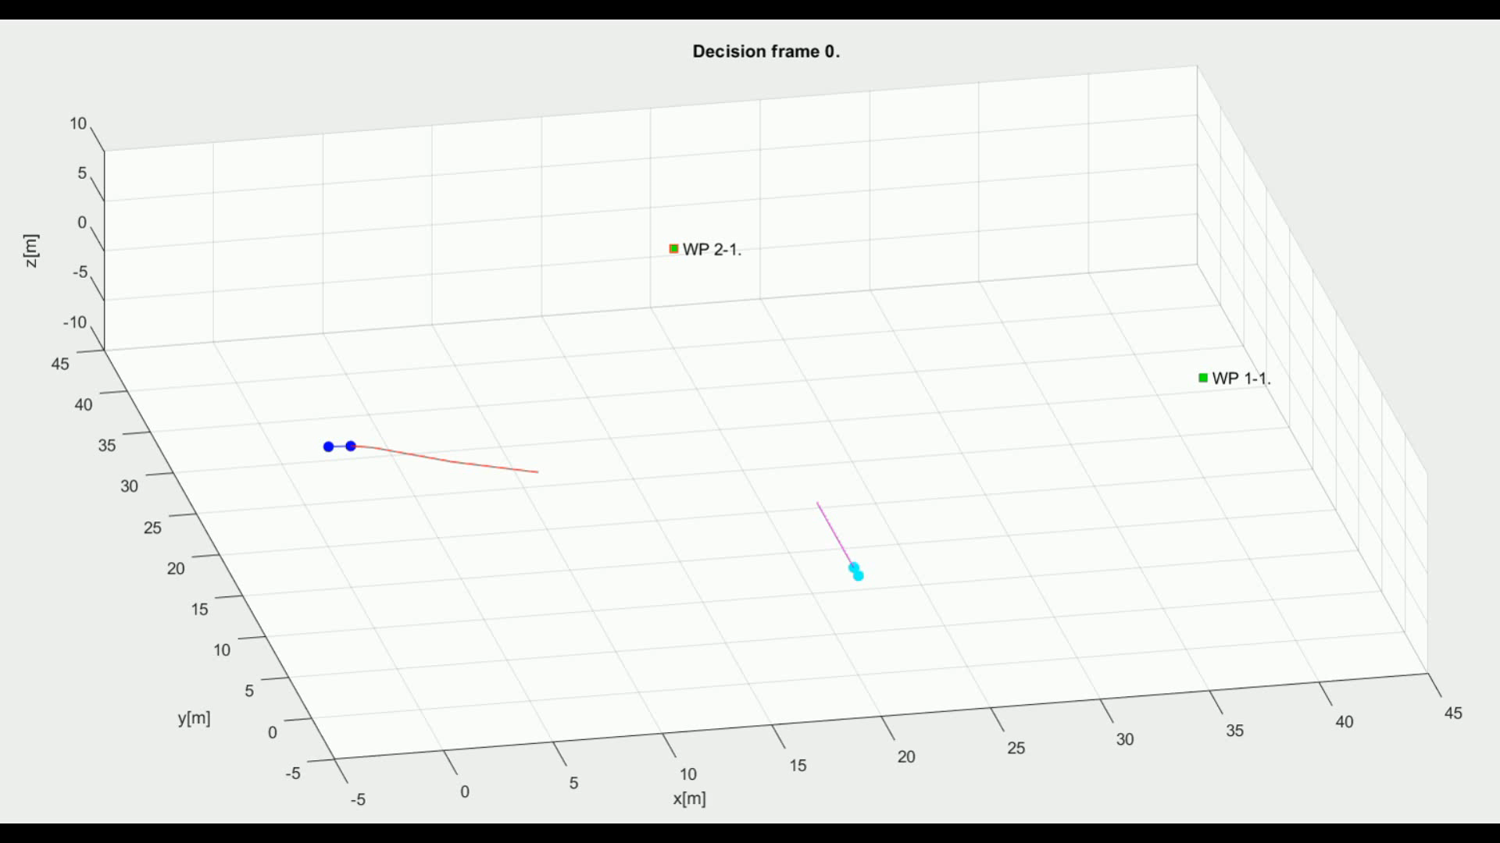
Rule-Based: Converging Maneuver

Slide 60
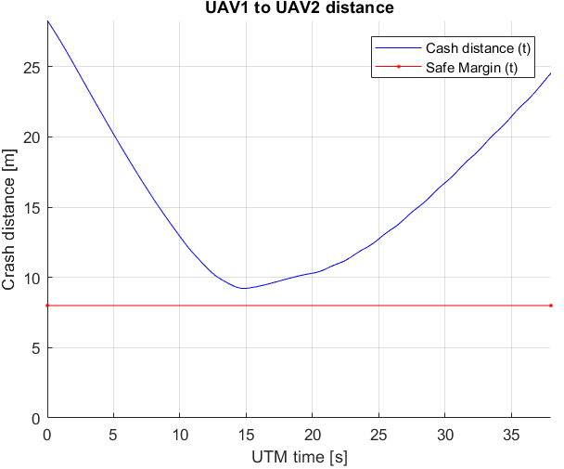
Rule-Based: Converging Maneuver
No Collision!

Slide 61
Head On Approach
Situation:
Two UAS systems equipped with ADS-B are approaching Collision Point
Both systems are using ACAS-XU Horizontal Separation
Angle of Approach is equal to 180 degrees
Resolution (Emergency)
Both UAS receive ADS-B message with intruder heading and position
Safety margin: 1.2 m (30 cm body radius, 30 cm protection margin)
Intruder model: Time-Based, Body mass intersection (r=60 cm)
Resolution (Rule Based)
Both UAS broadcasts ADS-B message to UTM system
UTM creates Collision Case and Mandates UAS with avoidance roles
Safety margin: 15-20 m (Enforced in navigation grids)

Slide 62
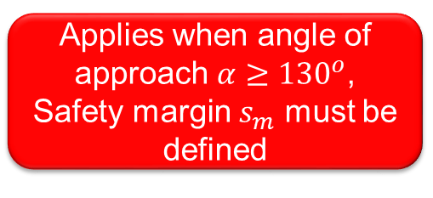
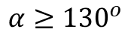
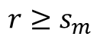
Head On Approach - Trigger
Quick Recapitulation Time!
$$α≥{130}^{o}$$
$$r≥s_{m}$$
Applies when angle of approach $α≥{130}^{o}$, Safety margin $s_{m}$ must be defined

Slide 63
Head On Approach - Resolution
$$r≥s_{m}$$
Both vehicles are taking right side avoidance

Slide 64
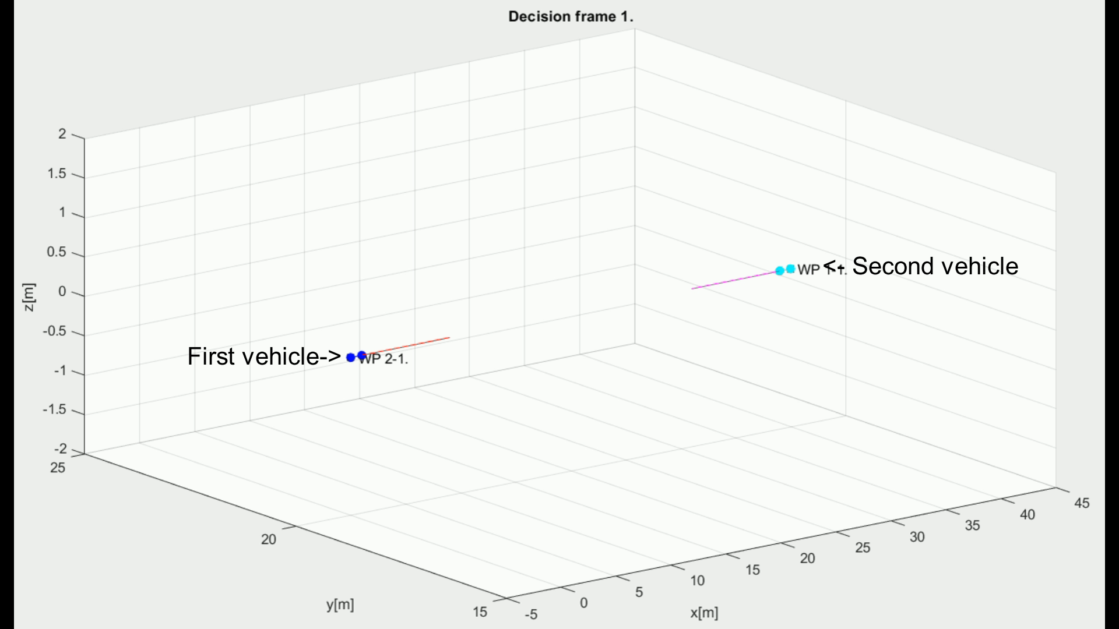
Emergency: Head On Approach

Slide 65
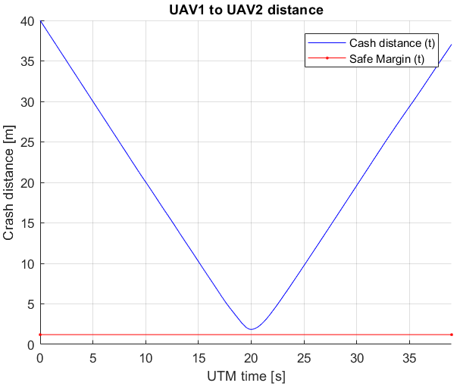
Emergency: Head On Approach
No Collision!

Slide 66
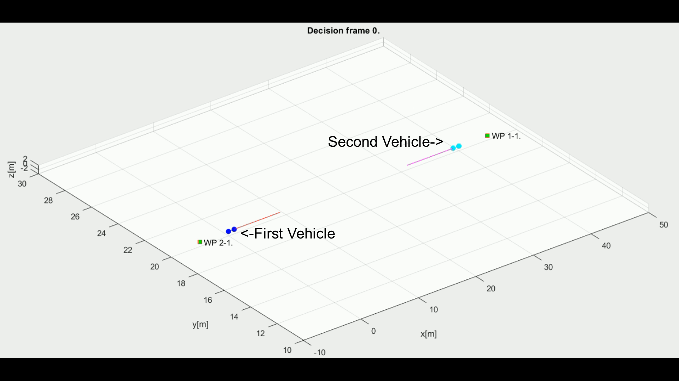
Rule-Based: Head On Approach

Slide 67
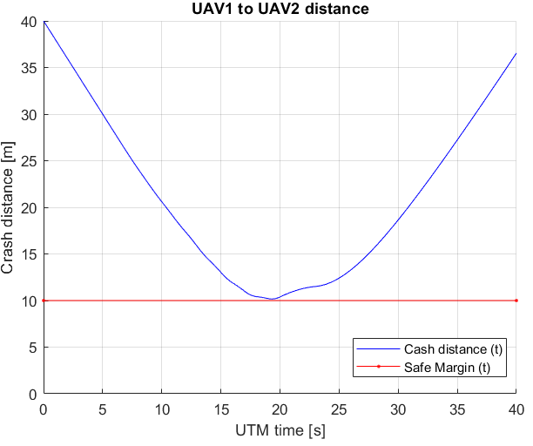
Rule-Based: Head On Approach
No Collision!

Slide 68
Multiple Collision Cases
Situation:
Four UAS systems equipped with ADS-B are approaching Collision Point
Both systems are using ACAS-XU Horizontal Separation
Angle of Approach is equal to 90-180 degrees (Multiple cases)
Resolution (Emergency)
All UAS receive ADS-B message with intruder heading and position
Safety margin: 1.2 m (30 cm body radius, 30 cm protection margin)
Intruder model: Time-Based, Body mass intersection (r=60 cm)
Resolution (Rule Based)
All UAS broadcasts ADS-B message to UTM system
UTM creates Collision Case and Mandates UAS with Avoidance Roles
Safety margin: 8 m (Enforced in Navigation Grid)

Slide 69
ACAS-XU Separation (Emergency Based)
Alert
UAS 1
UAS 3
Alert
Response
Consensus
UAS 1: Horizontal Separation
UAS 2: Vertical Separation
UAS 3: Tilted Left Separation
UAS 4: Tilted Right Separation
Response
Alert
UAS 2
Response
UAS 4

Slide 70
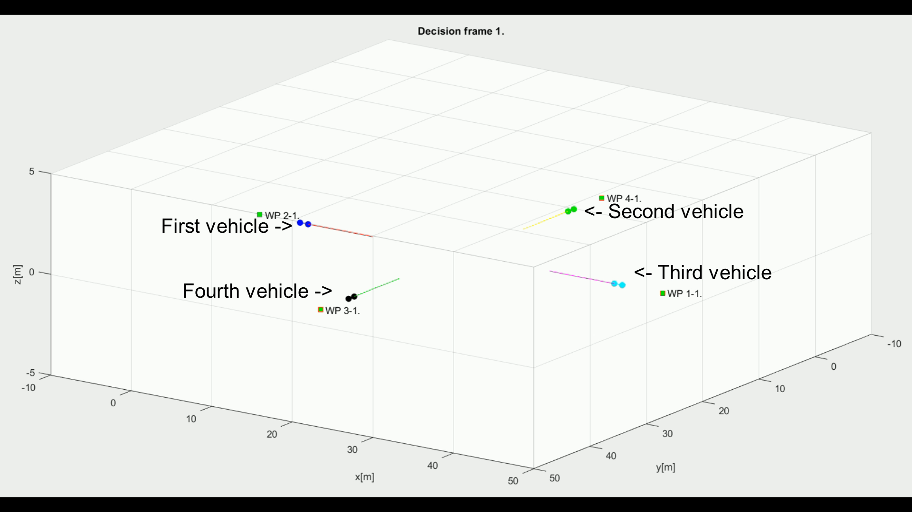
Emergency: Multiple Collision Cases

Slide 71
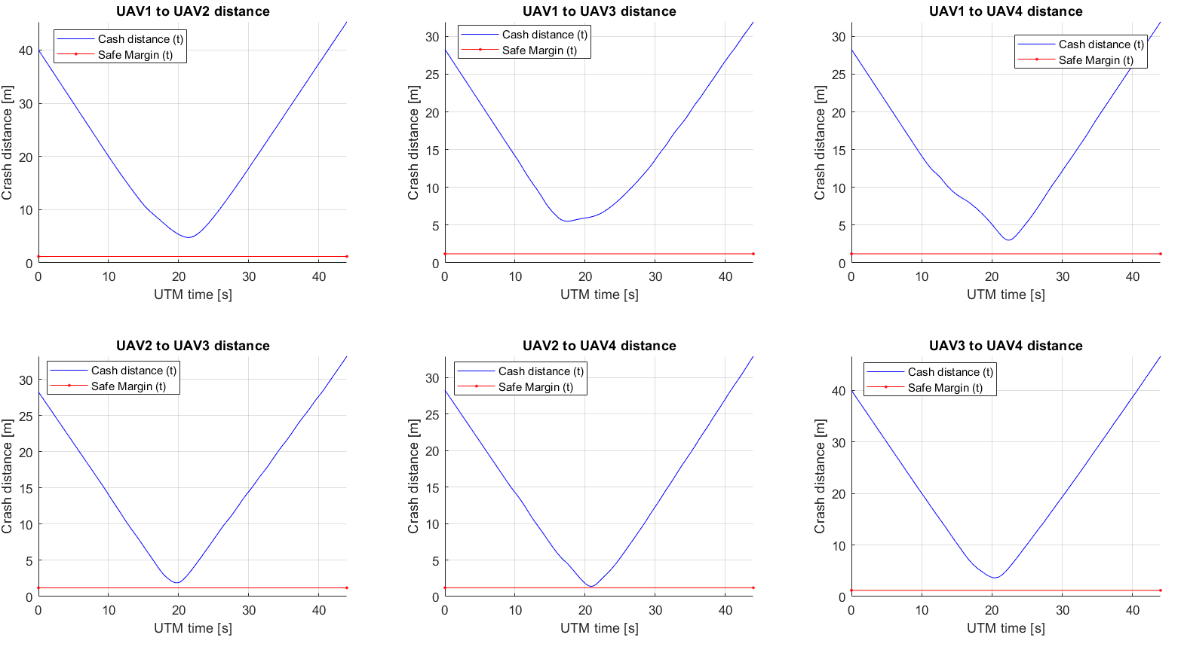
Emergency: Multiple Collision Cases
No Collision!

Slide 72
Enforced Virtual Roundabout (Rule-Based)
Position Notification
Position Notification
UAS 1
2
UAS 3
1
Calculate collision Cases
Create Virtual
Roundabout
Directive
Directive
UAS Traffic Management
Directive
Directive
Send
Directives
Enforce
Directives
3
4
UAS 2
UAS 4
Position Notification
Position Notification

Slide 73
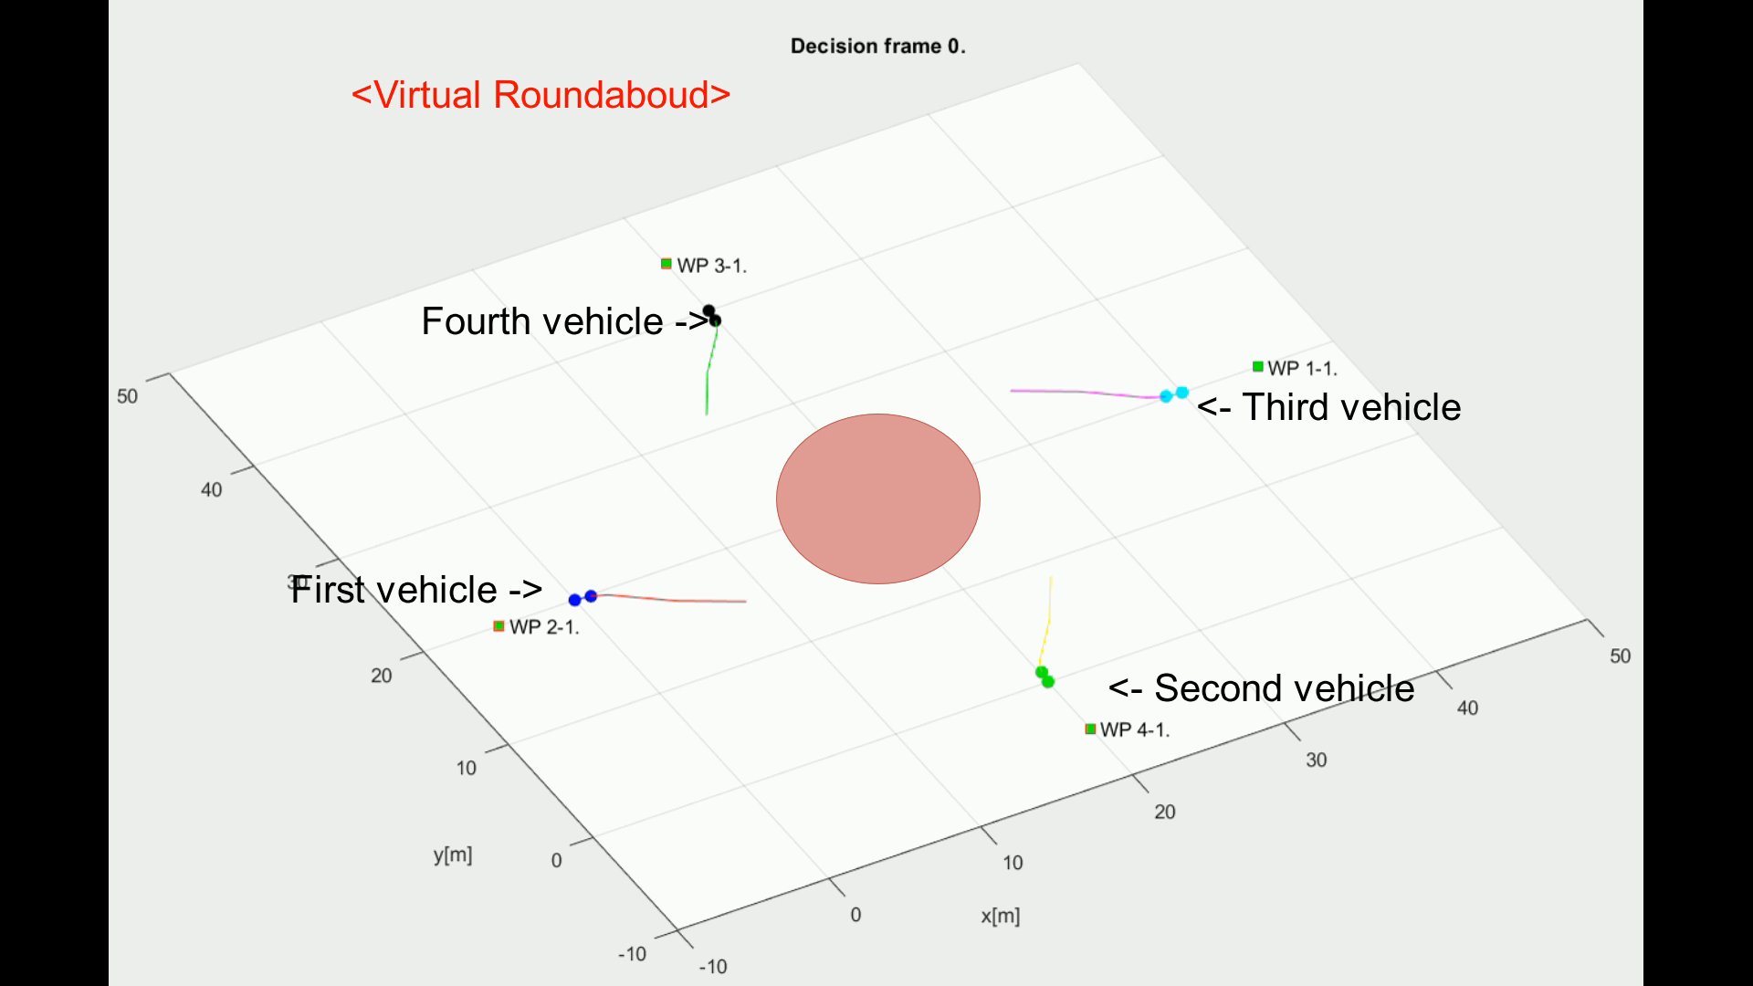
Rule-Based: Multiple Collision Cases

Slide 74
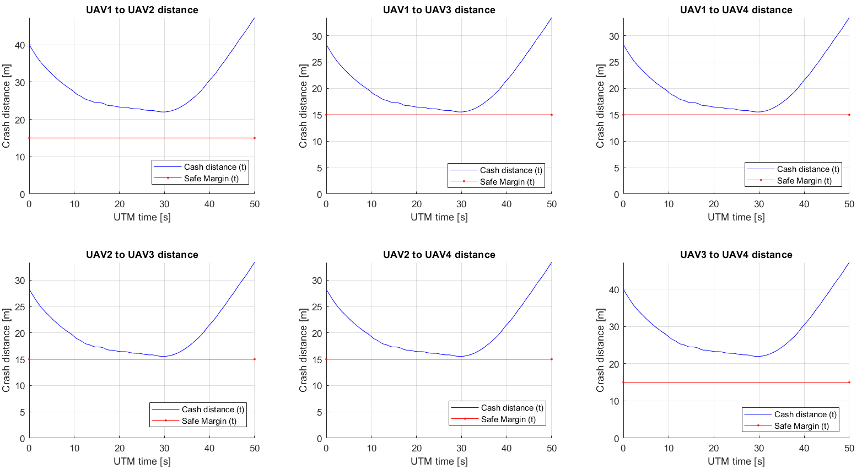
Rule-Based: Multiple Collision Cases
No Collision!

Slide 75
Overtake Maneuver
Situation:
Two UAS systems equipped with ADS-B are flying in same direction
Both systems are using ACAS-XU Horizontal Separation
Angle of Approach is equal to 0 degrees
Overtaken UAS is slower than Overtaking UAS
Resolution (Rule Based)
All UAS broadcasts ADS-B message to UTM system
UTM creates Collision Case and Mandates UAS with Avoidance Roles
Safety margin: 5 m (Enforced in Navigation Grid)
Simulation Scenarios:
Speed of Overtaking UAS is 2x higher than speed of Overtaken UAS
Speed of Overtaking UAS is 3x higher than speed of Overtaken UAS
Speed of Overtaking UAS is 4x higher than speed of Overtaken UAS

Slide 76
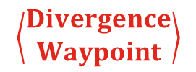
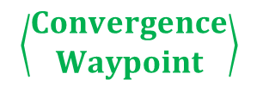
Overtake Maneuver - Trigger
$$\left\langle \begin{matrix}Convergence \\ Waypoint\end{matrix}\right\rangle$$
Quick Recapitulation Time!
$$\left\langle \begin{matrix}Divergence \\ Waypoint\end{matrix}\right\rangle$$
The aircraft being overtaken has the right of the way

Slide 77
Overtake Maneuver - Resolution
$$\left\langle \begin{matrix}Convergence \\ Waypoint\end{matrix}\right\rangle$$
$$\left\langle \begin{matrix}Divergence \\ Waypoint\end{matrix}\right\rangle$$
Overtake is executed from right

Slide 78
Overtake Maneuver – Leave Condition
$$\left\langle \begin{matrix}Convergence \\ Waypoint\end{matrix}\right\rangle$$
$$\left\langle \begin{matrix}Divergence \\ Waypoint\end{matrix}\right\rangle$$
Overtake rule may apply only when well clear condition is guaranteed

Slide 79
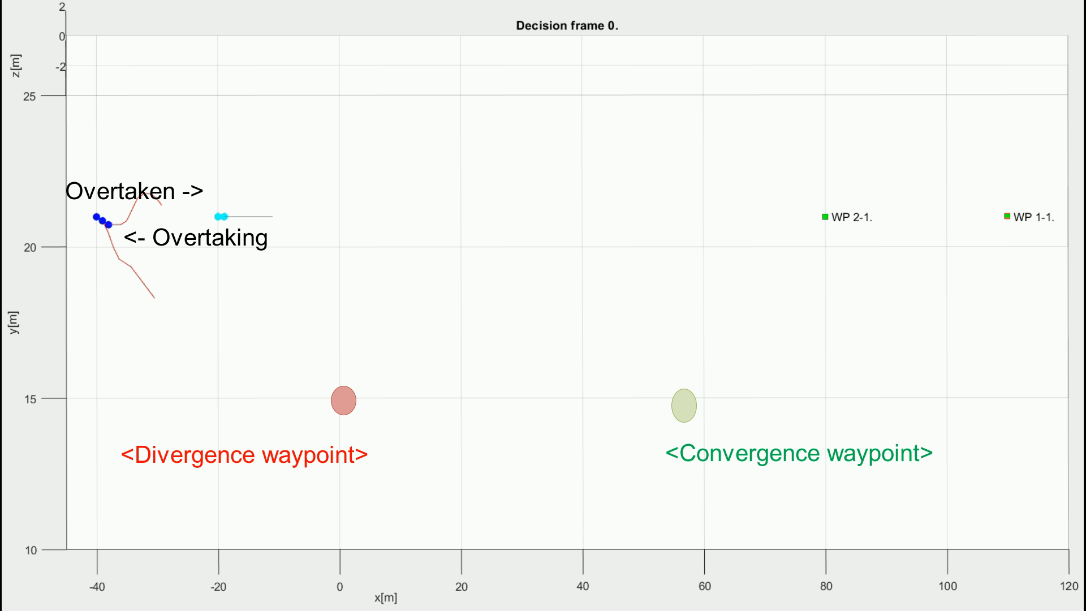
Rule-Based: Overtake Maneuver (3x speed)

Slide 80
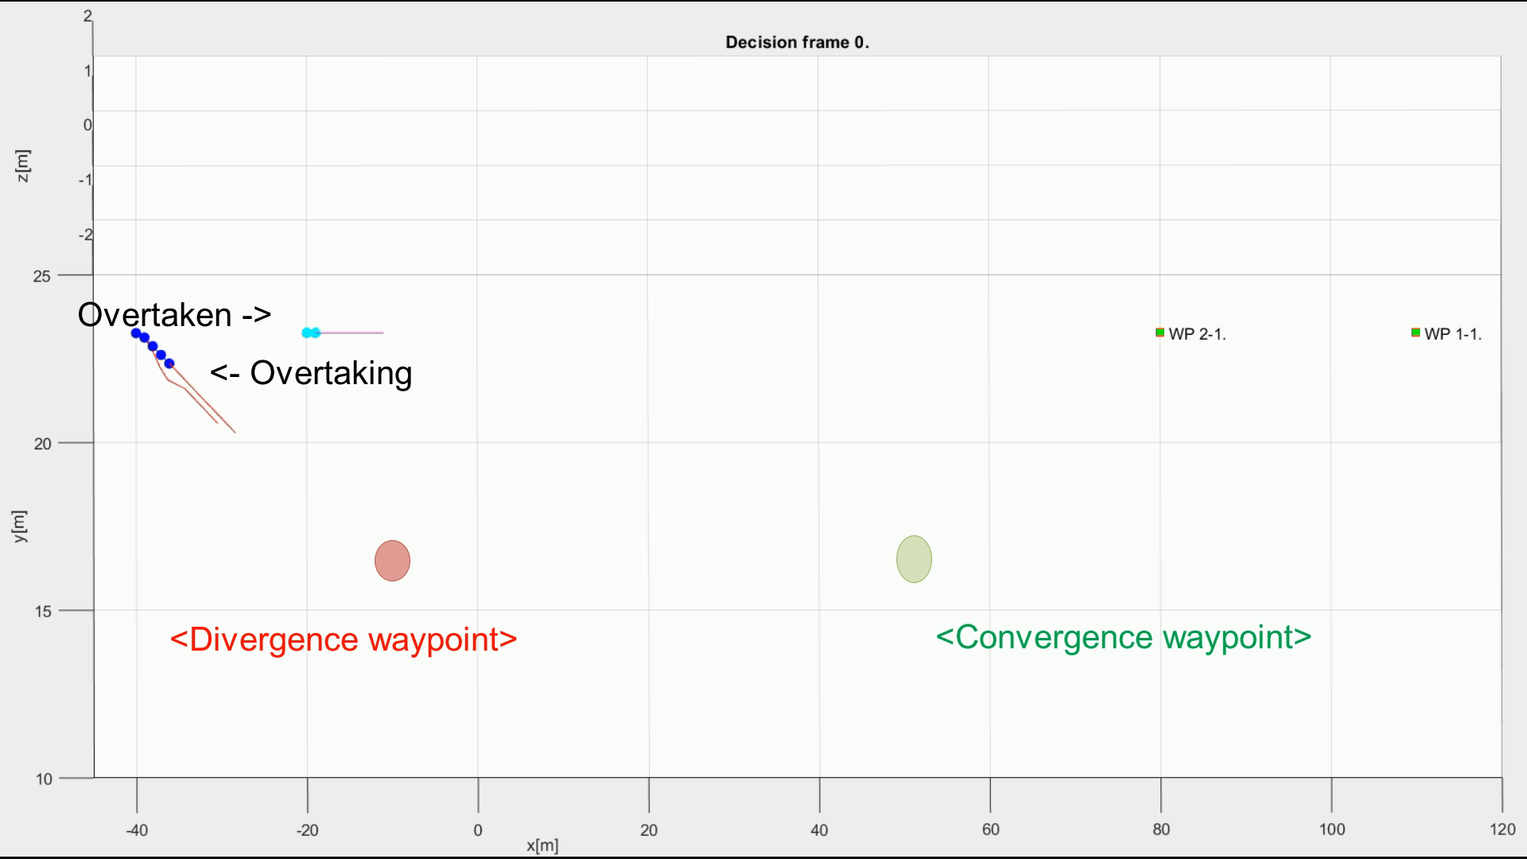
Rule-Based: Overtake Maneuver (3x Speed)

Slide 81

Rule-Based: Overtake Maneuver (4x Speed)

Slide 82

Rule-Based: Overtake Maneuver (Comparison)
Note changing shape of Overtake Trajectory

Slide 83

Rule-Based: Overtake Maneuver (Margins)
No Collision!
Note changing time of Closest Point

Slide 84

Conclusion and Future Work

Slide 85
Conclusion and Future Work
UAS Traffic Management Module provides following functionality:
Separation – keep Airspace traffic separated
Collision Prevention – prevent two or more airspace attendants collision
Conflict Resolution – give Directives when conflict arises.
Rule Engine is key enabler for:
Rules of the Air implementation, change behavior during avoidance,
Well Clear guarantee during Avoidance Maneuvers,
Advanced Functionality and Code Enhancement,
Mission plan enhancement by forcing Divergence/Convergence Waypoints
Future work:
Publish results with focus on current “Rules of Air shortcomings”
Propose Avoidance Priority based on:
Vehicle Maneuverability Class
Velocity/Acceleration/Deceleration Capabilities

Slide 86




Q&A Session

